Slide 1
Inheritance

Slide 2
Outline
Inheritance
Forms of Inheritance

Slide 3
Meaning of Inherit
To receive from a parent or ancestor by genetic transmission.

Slide 4
Inheritance in Java
In Java, it is possible to inherit attributes and methods from one class to another.
The new class that is created is known as a subclass (child or derived class)
The existing class from where the child class is derived is known as a superclass (parent or base class).

Slide 5



Superclass/Parent Class
Subclass/Child Class
Subclass/Child Class

Slide 6
Inheritance in Java
To inherit from a class, the extends keyword is used.

Slide 7
Parent Class
{
class
Mommy
protected String surname = “Ponio”;
protected variable
Public variable
public String getSurname() {
return this.surname;
}
Public variable
Public method
}

Slide 8
Parent Class
{
class
Mommy
protected String surname = “Ponio”;
Variables with a protected access modifier can only be accessed by the parent class and its child classes/sub classes.
Public variable
public String getSurname() {
return this.surname;
}
Public variable
Public method
}

Slide 9
Child Class
public class
Son extends Mommy
{
The extends keyword is used to inherit properties and methods from the parent class “Mommy”
String name;
}
public class
Daughter extends Mommy
{
String name;
}

Slide 10
Accessing inherited methods
{
public class App
public static void
main
(String[] args)
{
Son Me = new Son();
Me.Name = “Elizer”;
System.out.println(“My name is” + Me.getSurname());
}
Outputs ”Ponio”. surname property and getSurname() method is inherited from Mommy class.
}

Slide 11
Accessing inherited methods
{
public class App
public static void
main
(String[] args)
{
Daughter mysister = new Daughter();
mysister.Name = “Paola”;
System.out.println(“My name is” + Me.getSurname());
}
Outputs ”Ponio”. surname property and getSurname() method is inherited from Mommy class.
}

Slide 12
Final non-access modifier
final class
{
Mommy
protected String surname = “Ponio”;
Public variable
public String getSurname() {
return this.surname;
}
Public variable
Using the final keyword will prevent other classes from inheriting its properties
Public method
}

Slide 13
Outline
Inheritance
Forms of Inheritance

Slide 14

Forms of Inheritance
Single Inheritance
Multi-level Inheritance

Slide 15

Forms of Inheritance
Hierarchical Inheritance
Multiple Inheritance

Slide 16

Forms of Inheritance
Hybrid Inheritance

Slide 17
Single Inheritance
A child class is created from a single parent class.

Slide 18
public class
{
Mother
protected String surname;
}
public class
Daughter extends Mother
{
}

Slide 19
Multi-level Inheritance
A child class is created from another child class.

Slide 20
public class
Grandmother
{
protected String surname;
}
public class
Mommy extends Grandmother
{
}
public class
Daughter extends Mother
{
}

Slide 21
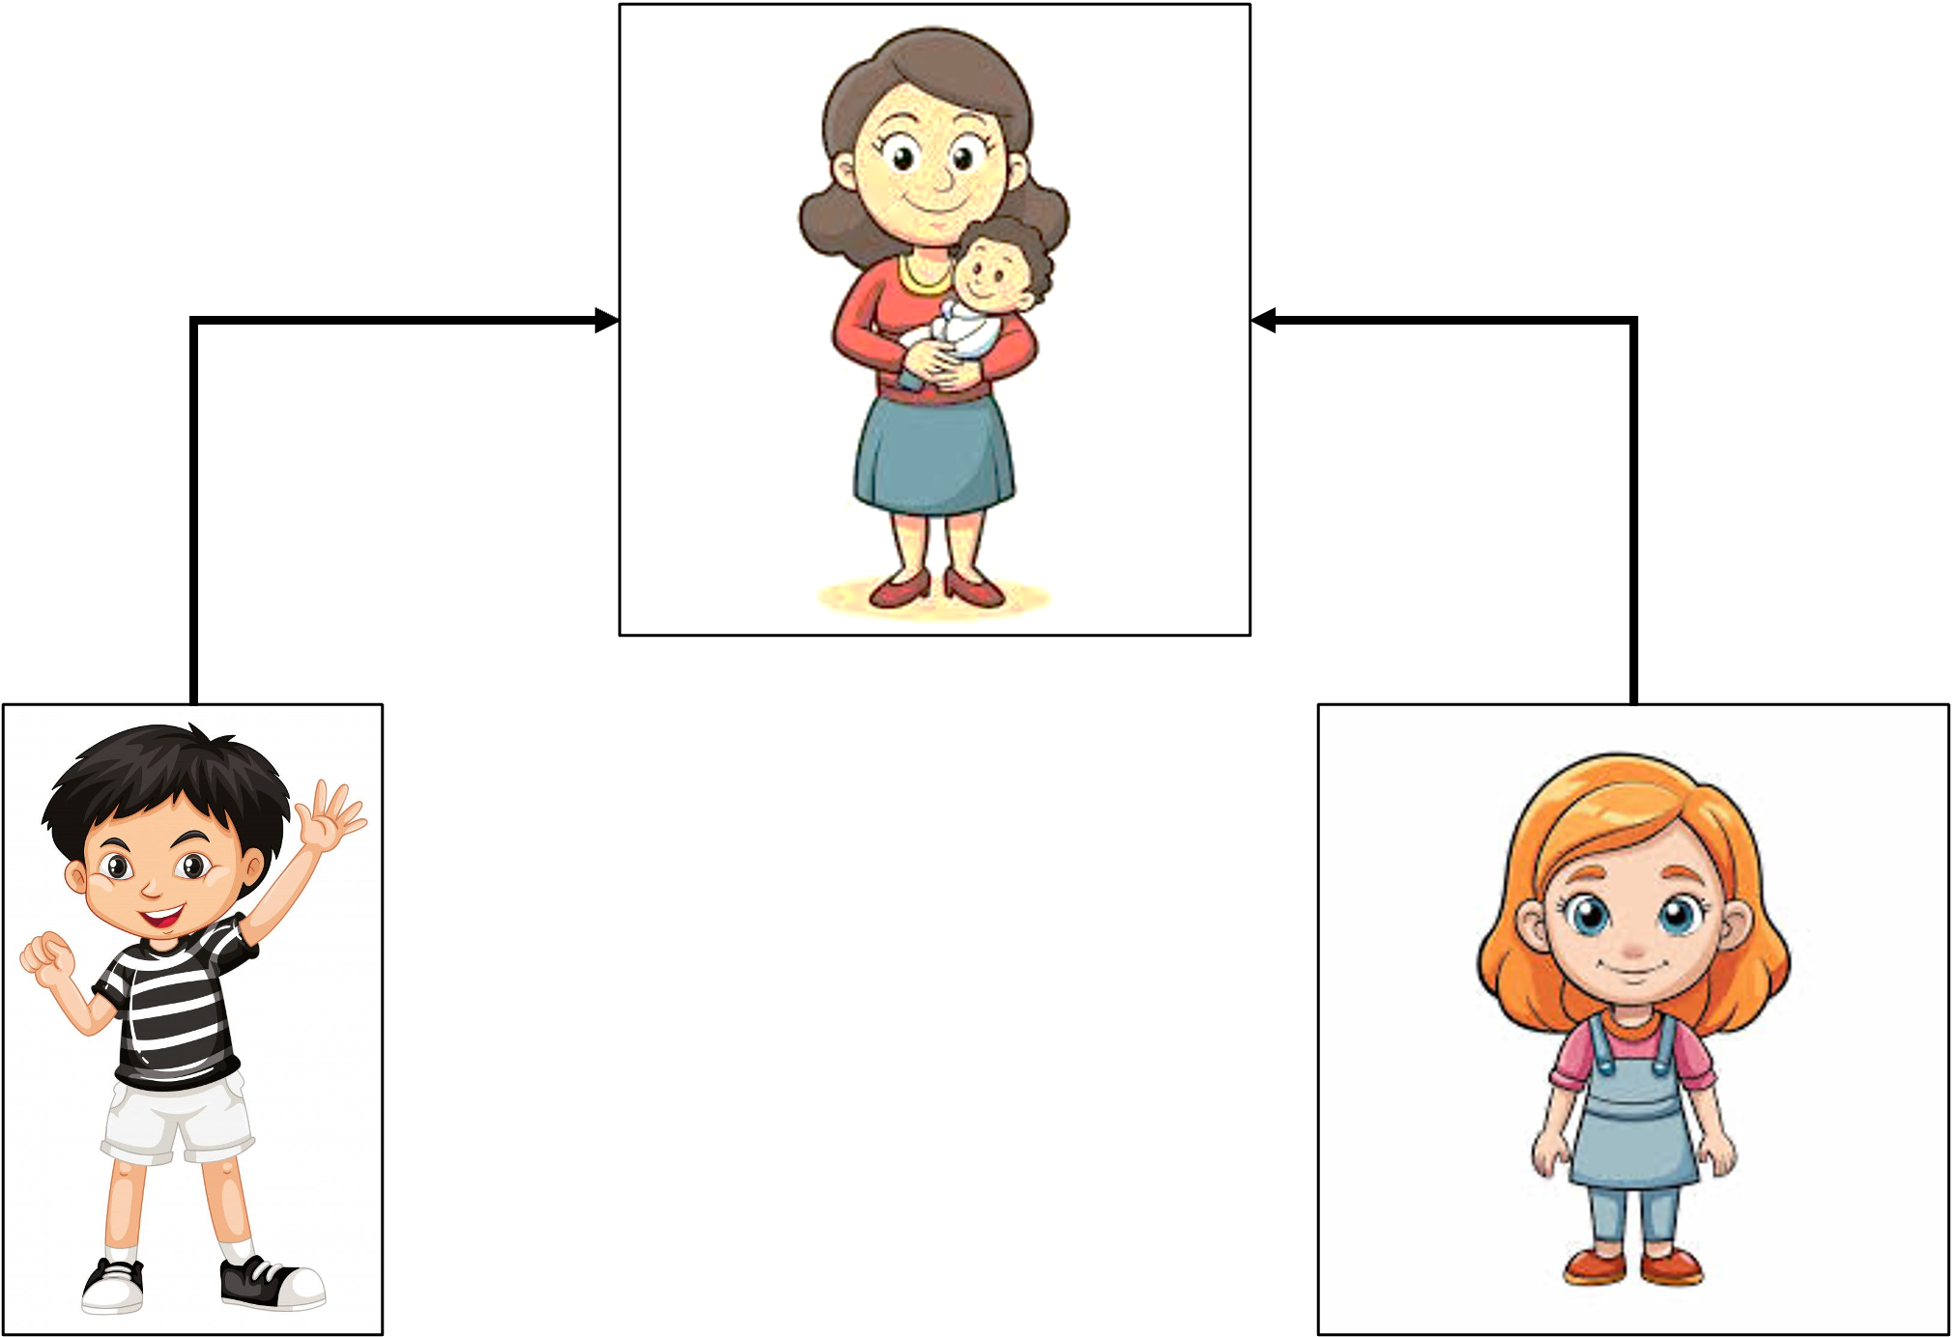
Hierarchical Inheritance
One class serves as a parent class for more than one child class.

Slide 22
public class
Mother
{
protected String surname;
}
public class
Son extends Mother
{
}
public class
Daughter extends Mother
{
}

Slide 23
Multiple Inheritance
One class can have more than one parent class and inherit features from all parent classes.
In Java, multiple inheritances can only be implemented. through interfaces.

Slide 24
interface
Father
{
}
interface
Mother
{
}
public class
Daughter implements Father, Mother
{
}

Slide 25
Hybrid Inheritance
A mix of two or more forms of inheritance.

Slide 26
{
interface
GrandFather
}
GrandMother
interface
{
}
public class
Mother implements GrandFather, GrandMother
{
}

Slide 27
public class
Son extends Mother
{
}
public class
Daughter extends Mother
{
}

